Slide 1
ECAS INSPECTION APP
Vishwa Swami

Slide 2
Front End => PowerApps

Slide 3
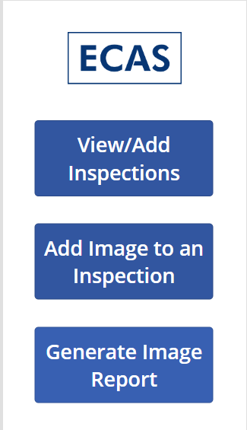
Power-App => HOME SCREEN

Slide 4
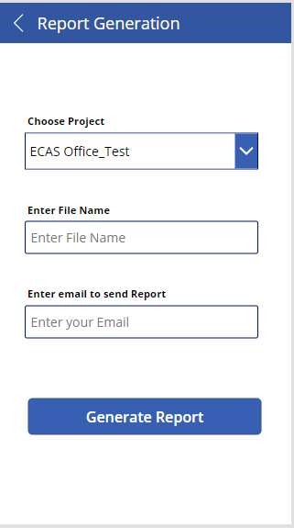
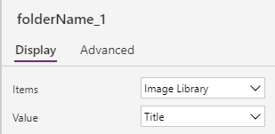
Power-App => GENERATE REPORT SCREEN

Slide 5

Power-App => LOAD IMAGE SCREEN
//Set(varTakenPhoto, Camera2.Stream);
ClearCollect(photos,Camera2.Stream);
Set(varPhotoName, "ECAS_" & Text(Now(), "[$-en-US]yyyy-mm-dd_hh-mm-ss") & ".png");
Navigate('Save Image_with Details',ScreenTransition.Fade);
//Navigate('Save Image',ScreenTransition.Fade);

Slide 6
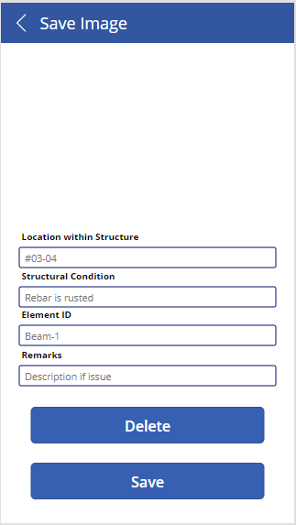
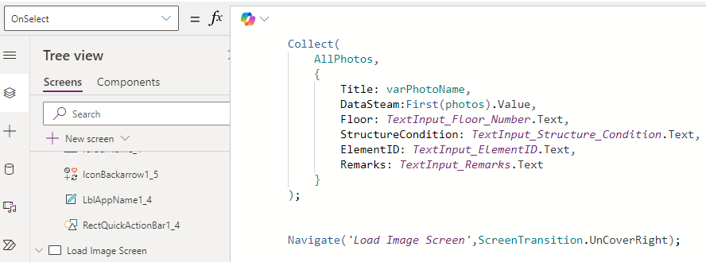
Power-App => SAVE IMAGE WITH DETAILS
Clear(photos);
Navigate('Load Image Screen',ScreenTransition.UnCoverRight);
Collect(
AllPhotos,
{
Title: varPhotoName,
DataSteam:First(photos).Value,
Floor: TextInput_Floor_Number.Text,
StructureCondition: TextInput_Structure_Condition.Text,
ElementID: TextInput_ElementID.Text,
Remarks: TextInput_Remarks.Text
}
);
Navigate('Load Image Screen',ScreenTransition.UnCoverRight);

Slide 7
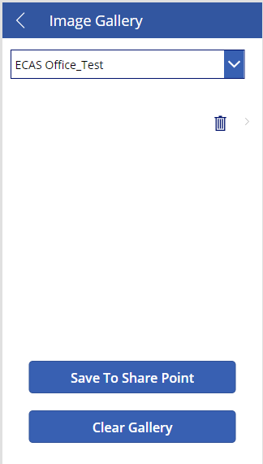

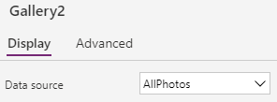

Power-App => IMAGE GALLERY
Savefilestofolder.Run(JSON(AllPhotos,JSONFormat.IncludeBinaryData),folderName.Selected.Name);

Slide 8
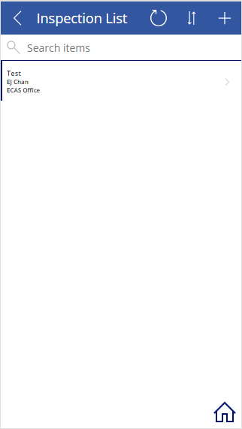


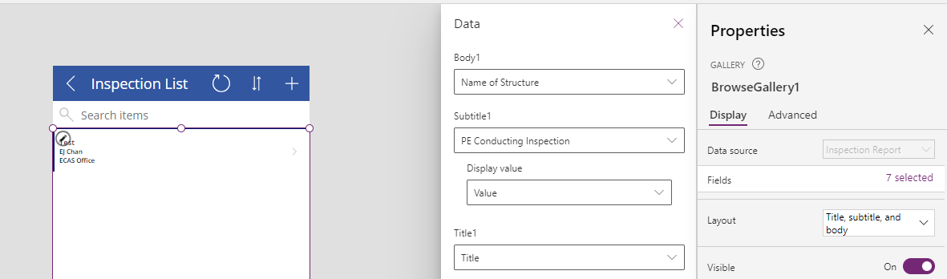
Power-App => INSPECTION LIST SCREEN

Slide 9
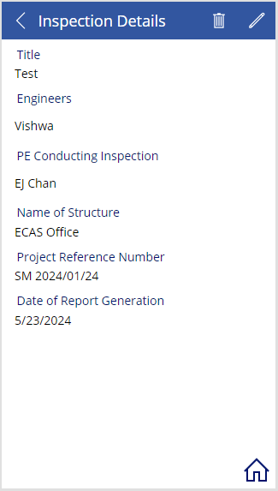

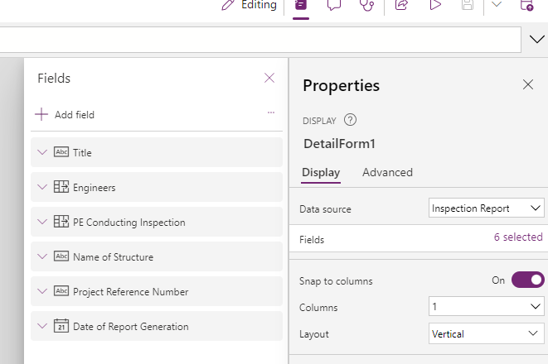
Power-App => INSPECTION LIST DETAILS

Slide 10
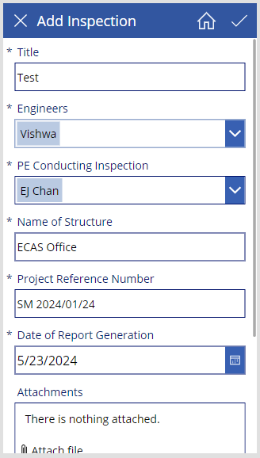
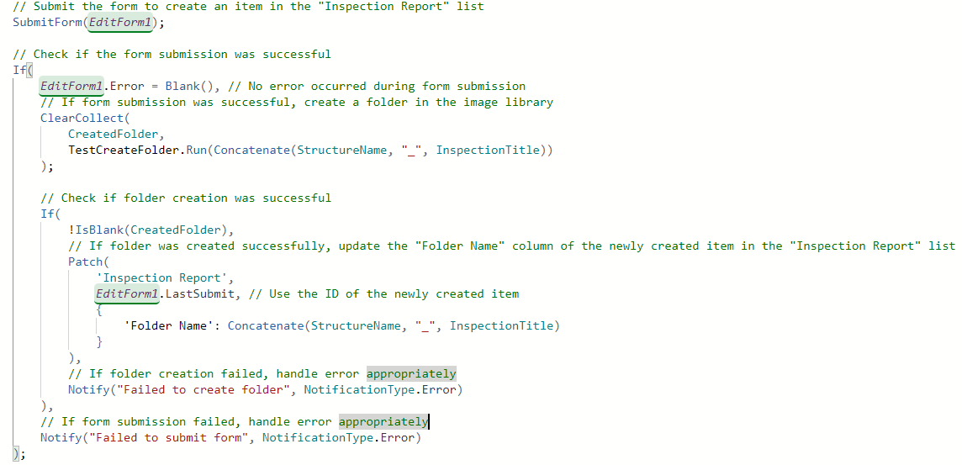
Power-App => ADD INSPECTION SCREEN
// Submit the form to create an item in the "Inspection Report" list
SubmitForm(EditForm1);
// Check if the form submission was successful
If(
EditForm1.Error = Blank(), // No error occurred during form submission
// If form submission was successful, create a folder in the image library
ClearCollect(
CreatedFolder,
TestCreateFolder.Run(Concatenate(StructureName, "_", InspectionTitle))
);
// Check if folder creation was successful
If(
!IsBlank(CreatedFolder),
// If folder was created successfully, update the "Folder Name" column of the newly created item in the "Inspection Report" list
Patch(
'Inspection Report',
EditForm1.LastSubmit, // Use the ID of the newly created item
{
'Folder Name': Concatenate(StructureName, "_", InspectionTitle)
}
),
// If folder creation failed, handle error appropriately
Notify("Failed to create folder", NotificationType.Error)
),
// If form submission failed, handle error appropriately
Notify("Failed to submit form", NotificationType.Error)
);

Slide 11
API's => Power Automate

Slide 12
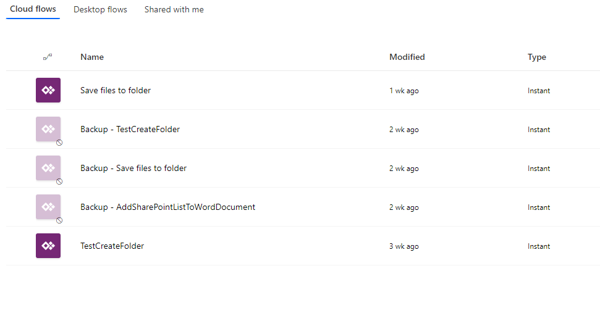
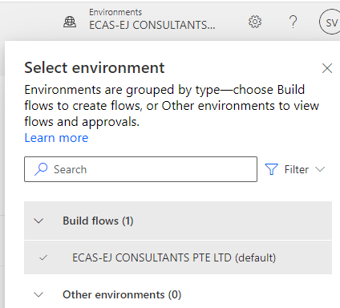
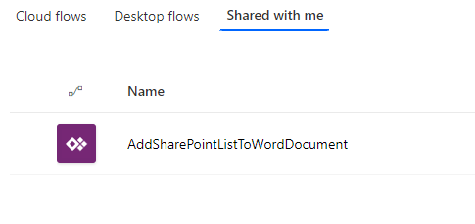
Power-Automate => 3 flows are used in Power app
BACKUP

Slide 13
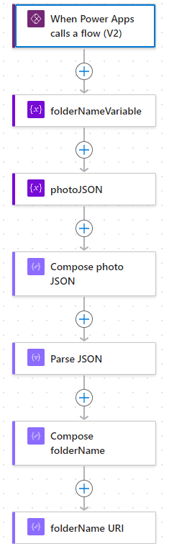
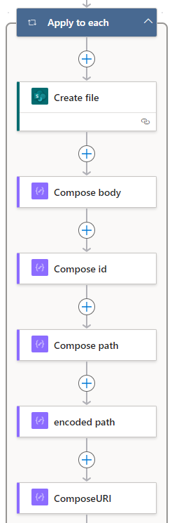
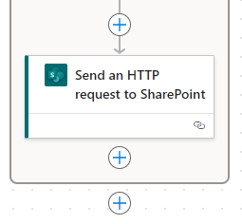
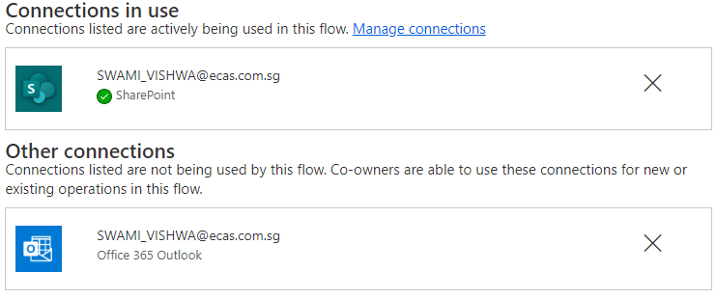
Power-Automate => Flow1: Save files to folder

Slide 14
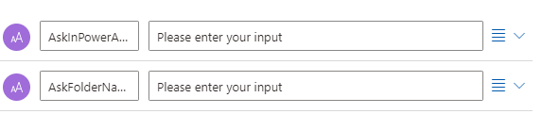


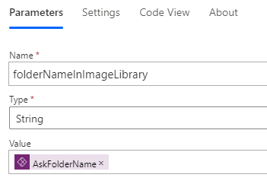


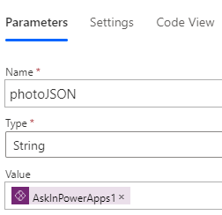

Power-Automate => Flow1: Save files to folder

Slide 15





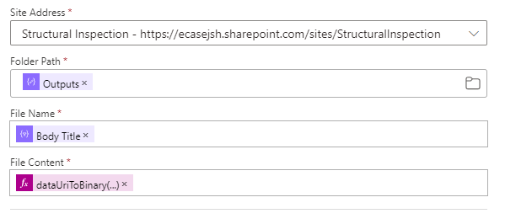

Power-Automate => Flow1: Save files to folder
{
"type": "array",
"items": {
"type": "object",
"properties": {
"DataSteam": {
"type": "string"
},
"ElementID": {
"type": "string"
},
"Floor": {
"type": "string"
},
"Remarks": {
"type": "string"
},
"StructureCondition": {
"type": "string"
},
"Title": {
"type": "string"
}
},
"required": [
"DataSteam",
"ElementID",
"Floor",
"Remarks",
"StructureCondition",
"Title"
]
}
}
uriComponent(triggerBody()?['text_1'])
dataUriToBinary(items('Apply_to_each')['DataSteam'])
"inputs": {
"parameters": {
"dataset": "https://ecasejsh.sharepoint.com/sites/StructuralInspection",
"folderPath": "@outputs('Compose_folderName')",
"name": "@items('Apply_to_each')['Title']",
"body": "@dataUriToBinary(items('Apply_to_each')['DataSteam'])"
}

Slide 16





Power-Automate => Flow1: Save files to folder
encodeUriComponent(concat('/sites/StructuralInspection',outputs('Create_file')?['body/Path']))
concat('_api/web/GetFileByServerRelativePath(decodedurl=''',outputs('encoded_path'),''')/ListItemAllFields')

Slide 17

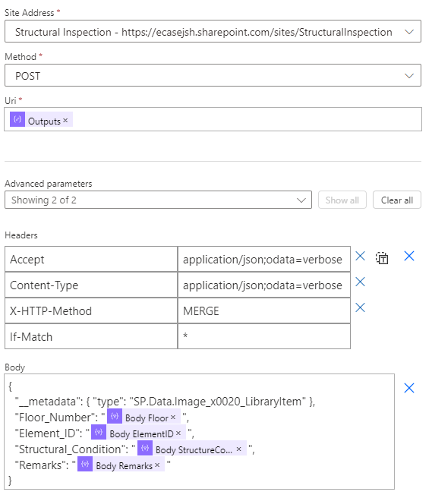
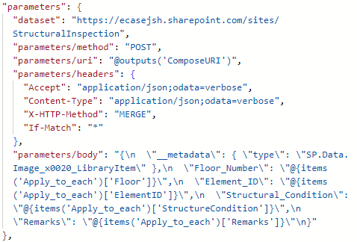
Power-Automate => Flow1: Save files to folder
Headers:
{
"Accept": "application/json;odata=verbose",
"Content-Type": "application/json;odata=verbose",
"X-HTTP-Method": "MERGE",
"If-Match": "*"
}
Body:
{
"__metadata": { "type": "SP.Data.Image_x0020_LibraryItem" },
"Floor_Number": "items('Apply_to_each')['Floor']",
"Element_ID": "items('Apply_to_each')['ElementID']",
"Structural_Condition": "items('Apply_to_each')['StructureCondition']",
"Remarks": "items('Apply_to_each')['Remarks']"
}

Slide 18
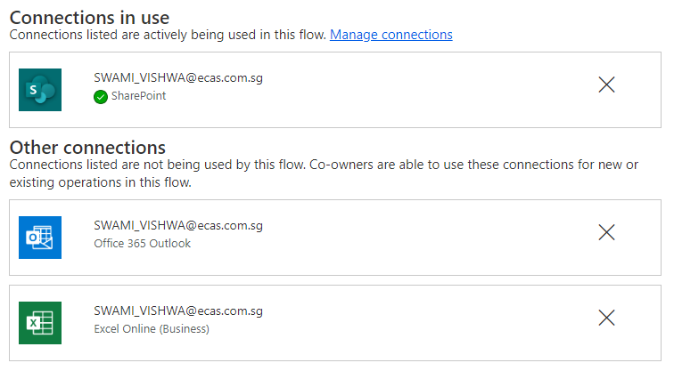
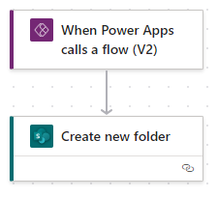
Power-Automate => Flow2: TestCreateFolder

Slide 19


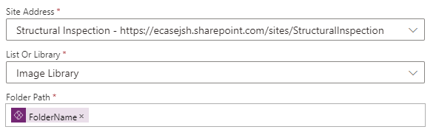

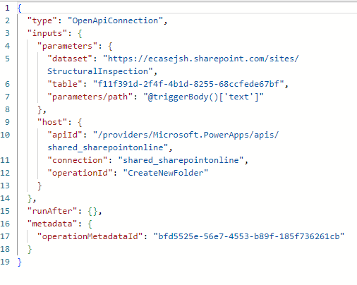

Power-Automate => Flow2: TestCreateFolder

Slide 20
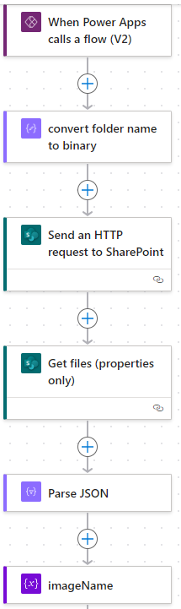
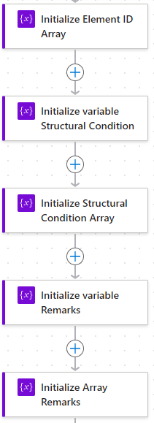
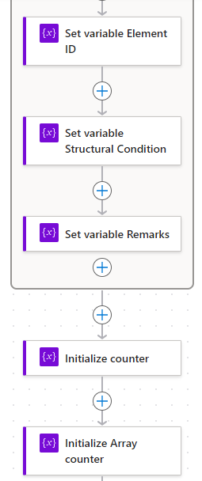
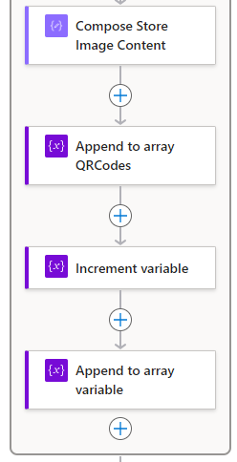
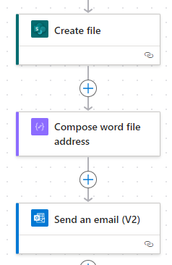
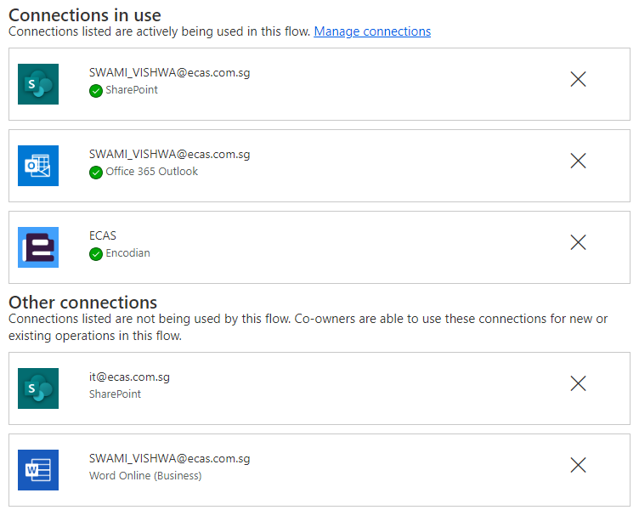
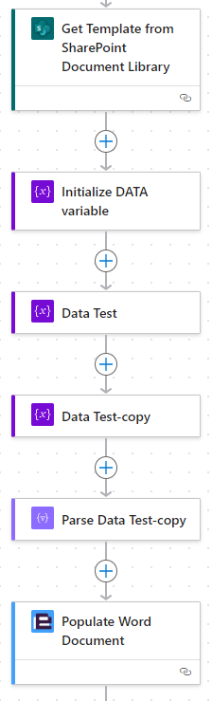
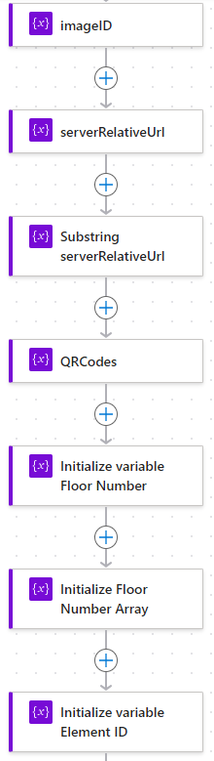
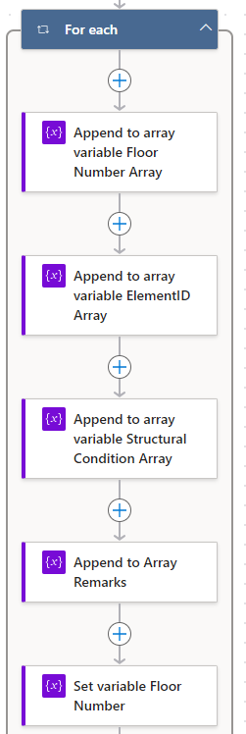
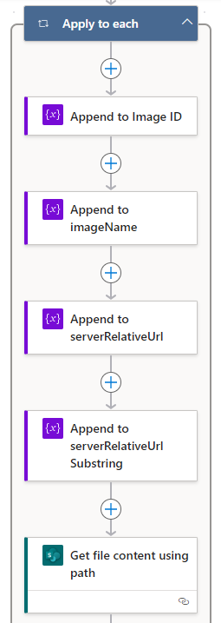
Power-Automate => Flow3: AddSharePointListToWordDocument

Slide 21

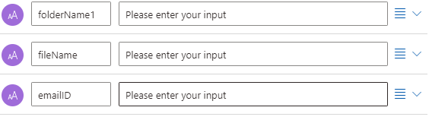


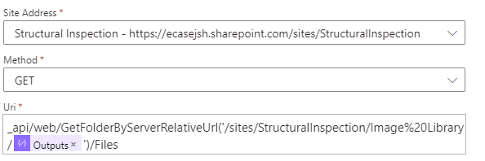

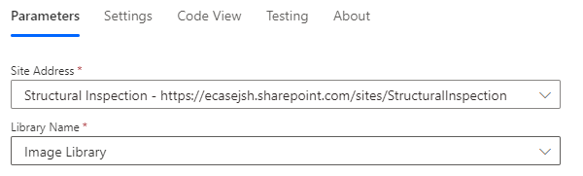
Power-Automate => Flow3: AddSharePointListToWordDocument
uriComponent(triggerBody()?['text'])
_api/web/GetFolderByServerRelativeUrl('/sites/StructuralInspection/Image%20Library/@{outputs('convert_folder_name_to_binary')}')/Files
"parameters": {
"dataset": "https://ecasejsh.sharepoint.com/sites/StructuralInspection",
"parameters/method": "GET",
"parameters/uri": "_api/web/GetFolderByServerRelativeUrl('/sites/StructuralInspection/Image%20Library/@{outputs('convert_folder_name_to_binary')}')/Files"
},

Slide 22


Power-Automate => Flow3: AddSharePointListToWordDocument
outputs('Get_files_(properties_only)')?['body/value']
{
"type": "array",
"items": {
"type": "object",
"properties": {
"@@odata.etag": {
"type": "string"
},
"ItemInternalId": {
"type": "string"
},
"ID": {
"type": "integer"
},
"Title": {
"type": "string"
},
"Modified": {
"type": "string"
},
"Editor": {
"type": "object",
"properties": {
"@@odata.type": {
"type": "string"
},
"Claims": {
"type": "string"
},
"DisplayName": {
"type": "string"
},
"Email": {
"type": "string"
},
"Picture": {
"type": "string"
},
"Department": {
"type": "string"
},
"JobTitle": {
"type": "string"
}
}
},
"Editor#Claims": {
"type": "string"
},
"MediaServiceImageTags": {
"type": "array"
},
"MediaServiceImageTags@odata.type": {
"type": "string"
},
"MediaServiceImageTags#WssId": {
"type": "array"
},
"MediaServiceImageTags#WssId@odata.type": {
"type": "string"
},
"Created": {
"type": "string"
},
"Author": {
"type": "object",
"properties": {
"@@odata.type": {
"type": "string"
},
"Claims": {
"type": "string"
},
"DisplayName": {
"type": "string"
},
"Email": {
"type": "string"
},
"Picture": {
"type": "string"
},
"Department": {},
"JobTitle": {}
}
},
"Author#Claims": {
"type": "string"
},
"OData__DisplayName": {
"type": "string"
},
"{Identifier}": {
"type": "string"
},
"{IsFolder}": {
"type": "boolean"
},
"{Thumbnail}": {
"type": "object",
"properties": {
"Large": {},
"Medium": {},
"Small": {}
}
},
"{Link}": {
"type": "string"
},
"{Name}": {
"type": "string"
},
"{FilenameWithExtension}": {
"type": "string"
},
"{Path}": {
"type": "string"
},
"{FullPath}": {
"type": "string"
},
"{IsCheckedOut}": {
"type": "boolean"
},
"{VersionNumber}": {
"type": "string"
},
"Element_ID": {
"type": "string"
},
"Floor_Number": {
"type": "string"
},
"Structural_Condition": {
"type": "string"
}
},
"required": [
"@@odata.etag",
"ItemInternalId",
"ID",
"Modified",
"Editor",
"Editor#Claims",
"MediaServiceImageTags",
"MediaServiceImageTags@odata.type",
"MediaServiceImageTags#WssId",
"MediaServiceImageTags#WssId@odata.type",
"Created",
"Author",
"Author#Claims",
"OData__DisplayName",
"{Identifier}",
"{IsFolder}",
"{Thumbnail}",
"{Link}",
"{Name}",
"{FilenameWithExtension}",
"{Path}",
"{FullPath}",
"{IsCheckedOut}",
"{VersionNumber}"
]
}
}

Slide 23

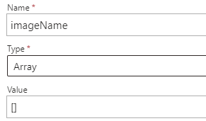

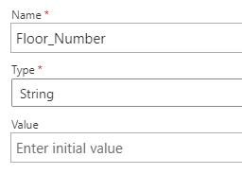
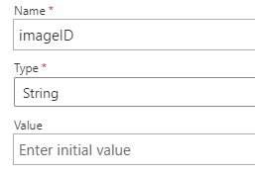


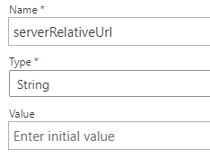
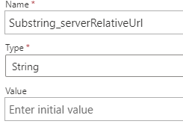


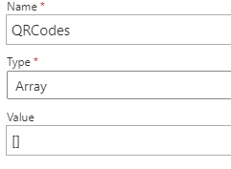
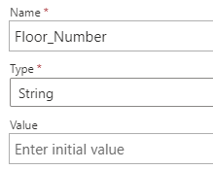

Power-Automate => Flow3: AddSharePointListToWordDocument

Slide 24












Power-Automate => Flow3: AddSharePointListToWordDocument

Slide 25






Power-Automate => Flow3: AddSharePointListToWordDocument
coalesce(items('For_each')?['Floor_Number'],'NULL')
coalesce(items('For_each')?['Element_ID'],'NULL')
coalesce(items('For_each')?['Structural_Condition'],'NULL')
coalesce(items('For_each')?['Remarks'],'NULL')
items('For_each')?['Floor_Number']

Slide 26








Power-Automate => Flow3: AddSharePointListToWordDocument
item()?['Element_ID']
item()?['Structural_Condition']
items('For_each')?['Remarks']
items('Apply_to_each')['UniqueId']

Slide 27







Power-Automate => Flow3: AddSharePointListToWordDocument
item()?['Structural_Condition']
items('Apply_to_each')['ServerRelativeUrl']
substring(items('Apply_to_each')['ServerRelativeUrl'],27)
substring(items('Apply_to_each')['ServerRelativeUrl'],27)
base64(body('Get_file_content_using_path'))
base64(body('Get_file_content_using_path'))

Slide 28








Power-Automate => Flow3: AddSharePointListToWordDocument
body('Get_Template_from_SharePoint_Document_Library')

Slide 29




Power-Automate => Flow3: AddSharePointListToWordDocument
concat('https://ecasejsh.sharepoint.com/sites/StructuralInspection',outputs('Create_file')?['body/Path'])
substring(triggerBody()?['text_2'],0,indexOf(triggerBody()?['text_2'],'@'))
2) <a href="@{outputs('Compose_word_file_address')}"> <u><b><strong>HERE</strong></b></u> </a>

Slide 30
Data Base - SharePoint

Slide 31

SharePoint=> Site: Structural Inspection
SharePoint Site: Structural Inspection

Slide 32

SharePoint => Inspection Report - LIST

Slide 33
SharePoint => PE List - LIST

Slide 34

SharePoint=> Engineer List - LIST

Slide 35

SharePoint=> Image Library – DOCUMENT LIBRARY
Whenever an Item is created in Inspection Report List, a folder is created here. All the images captured from App will be saved in that folder.

Slide 36

SharePoint=> Document
All the Autogenerated report will be saved in 02_AutoGenerated Reports folder.
Report template is saved in Encodian_Template folder

Slide 37


SharePoint=> Document

Slide 38
Thank you

